Slide 1
Real Data Experimental Results
Distributed Monitoring
April 2019

Slide 2
Table of Contents
Entropy
AMS F₂
Spectral Gap
Inner Product

Slide 3
Entropy

Slide 4
Data
Database accesses
https://www.kaggle.com/eyalgut/binary-traffic-matrices/version/2
4,702 users, distributed by a hash function
11,654 database entries
1488 hours of usage
Goal: DDOS Anomaly detection

Slide 5
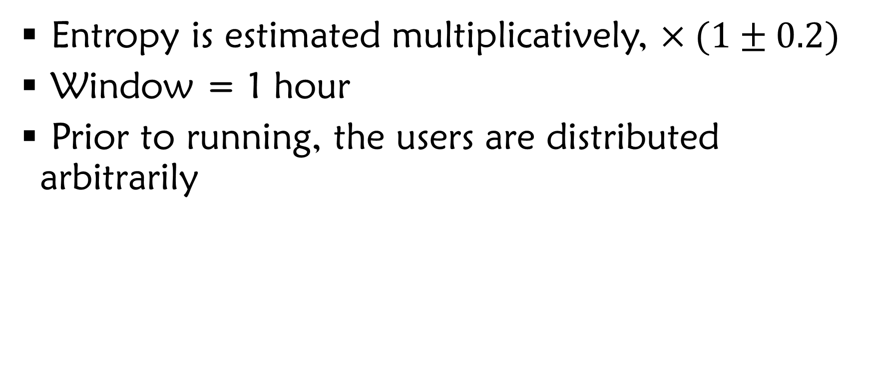
Running Details
Entropy is estimated multiplicatively, $×(1±0.2)$
Window = 1 hour
Prior to running, the users are distributed arbitrarily

Slide 6
How the Data Looks
Entropy
Time

Slide 7
How the Data Looks, 2 servers
Entropy
Time

Slide 8
How the Data Looks, 2 servers
Entropy
First 200 hours
Time

Slide 9
How the Data Looks, 8 servers
Entropy
First 100 hours
Time

Slide 10
8 servers, Bandwidth / time
Bandwidth
time

Slide 11
Bandwidth / # nodes
Bandwidth
# nodes

Slide 12

Running Details
Entropy is estimated multiplicatively, $×(1±0.2)$
Window = 5 hour
Round-robin distribution of data

Slide 13
AMS F₂

Slide 14
Data
Random data, when only one server changes.
5 Servers
Data is captured until the fourth full sync of the Oracle

Slide 15
Width = 30, Height = 31
Bandwidth
Time

Slide 16
Bandwidth / |vector|
Bandwidth
|vector|

Slide 17
(Bandwidth / Oracle Bandwidth) / |vector|
Bandwidth
|vector|

Slide 18
Data
Database accesses
https://www.kaggle.com/eyalgut/binary-traffic-matrices/version/2
4,702 users, distributed by a hash function
11,654 database entries
1488 hours of usage
Goal: DDOS Anomaly detection

Slide 19
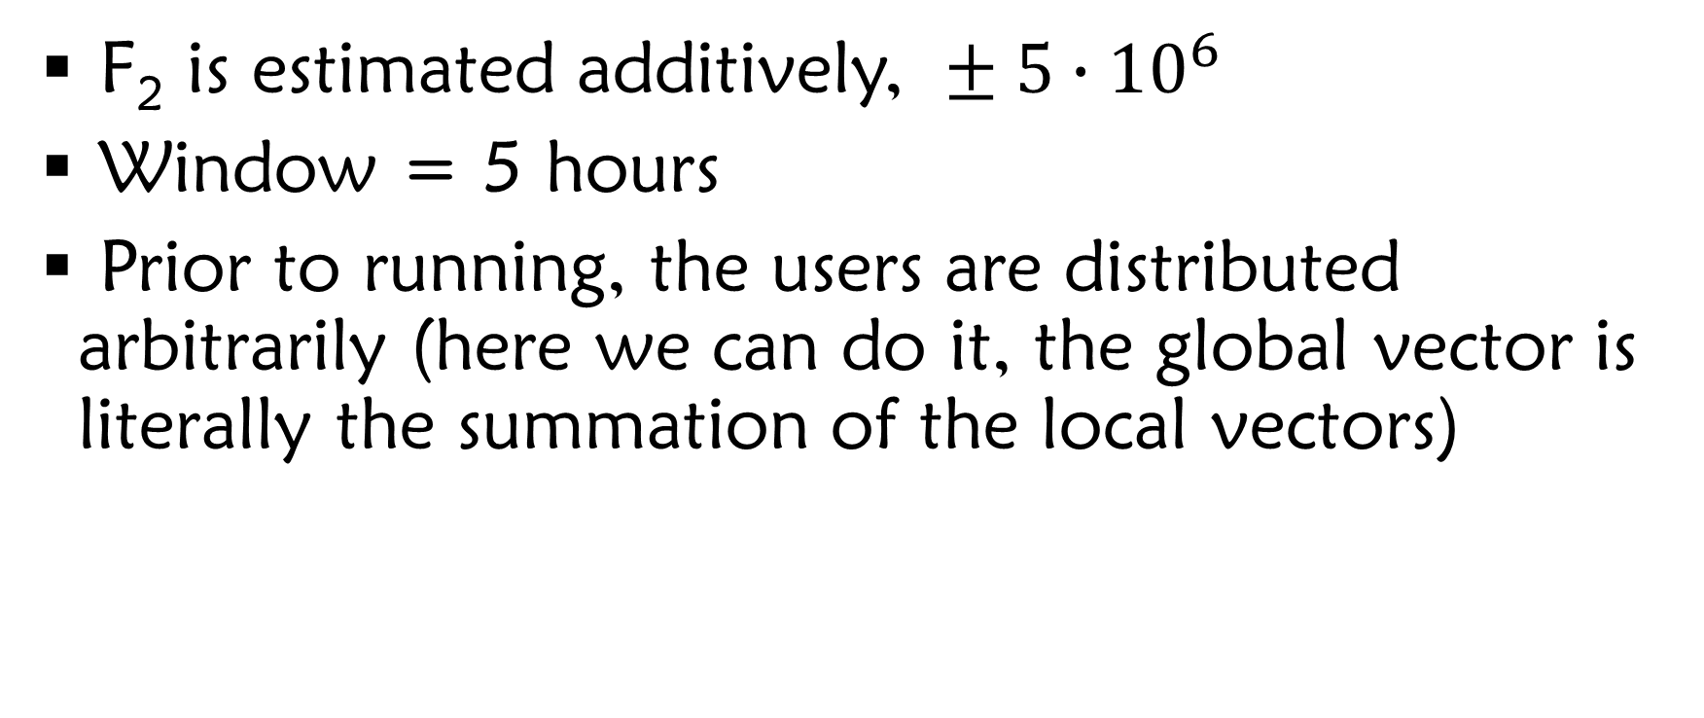
Running Details
F₂ is estimated additively, $± 5∙{10}^{6}$
Window = 5 hours
Prior to running, the users are distributed arbitrarily (here we can do it, the global vector is literally the summation of the local vectors)

Slide 20
Spectral Gap

Slide 21
Inner Product

Slide 25
Experimental Results

Slide 26
Inner Product

Slide 27
Bag-of-Words Textual Data Sources
Tweets from the end of 2009
Blogs textual data
Restaurant Reviews
Reddit comments from 2015
Spam click-baits new headlines
News pieces from India
Wikipedia article as of March 2017
Amazon reviews of movies
X
<X,Y>
Y

Slide 28
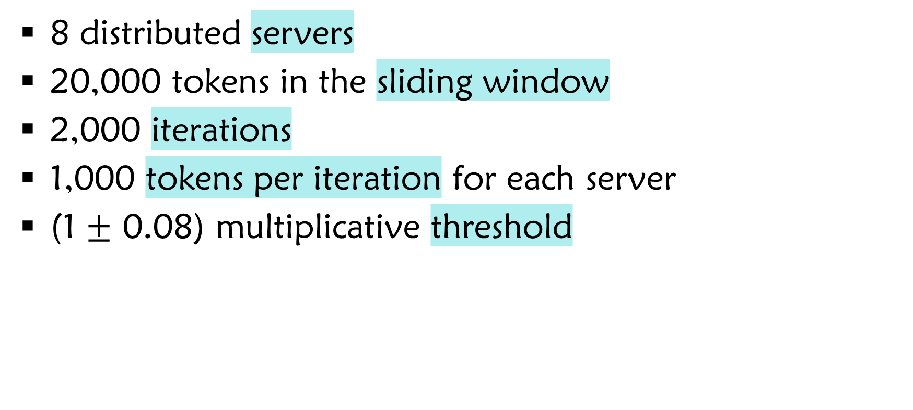
Parameters
8 distributed servers
20,000 tokens in the sliding window
2,000 iterations
1,000 tokens per iteration for each server
(1 $±$ 0.08) multiplicative threshold

Slide 29
Bandwidth / iteration |vector|=5,000
Bandwidth
Iteration

Slide 30
Bandwidth / iteration |vector|=5,000
Bandwidth
Iteration

Slide 31
Bandwidth / |vector|
Bandwidth
|vector|

Slide 32
Bandwidth / |vector|
Bandwidth
|vector|

Slide 33
Average Amount of Full Syncs Compared to Oracle
Full Syncs
Scheme

Slide 34
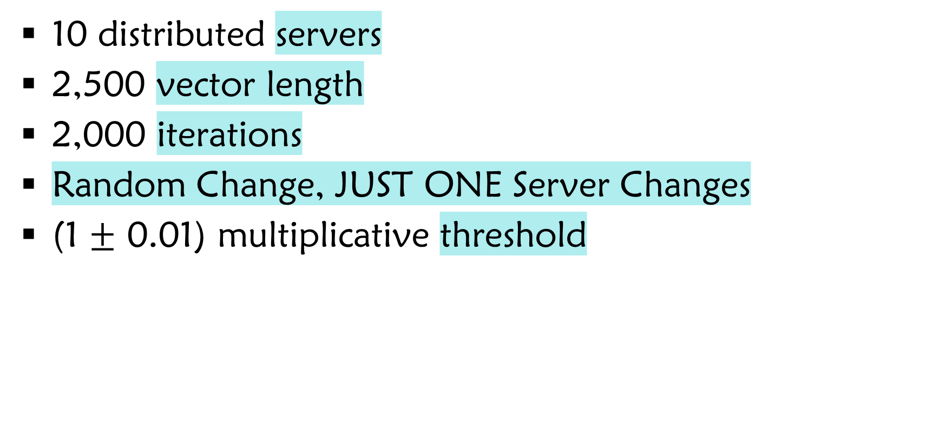
Parameters
10 distributed servers
2,500 vector length
2,000 iterations
Random Change, JUST ONE Server Changes
(1 $±$ 0.01) multiplicative threshold

Slide 35
Bandwidth / iteration
Bandwidth
Iteration

Slide 36
Bandwidth / iteration
Bandwidth
Iteration

Slide 37
Entropy

Slide 38
Bag-of-Words Textual Data Sources
Tweets from the end of 2009
Blogs textual data
Restaurant Reviews
Reddit comments from 2015
Spam click-baits new headlines
News pieces from India
Wikipedia article as of March 2017
Amazon reviews of movies

Slide 39
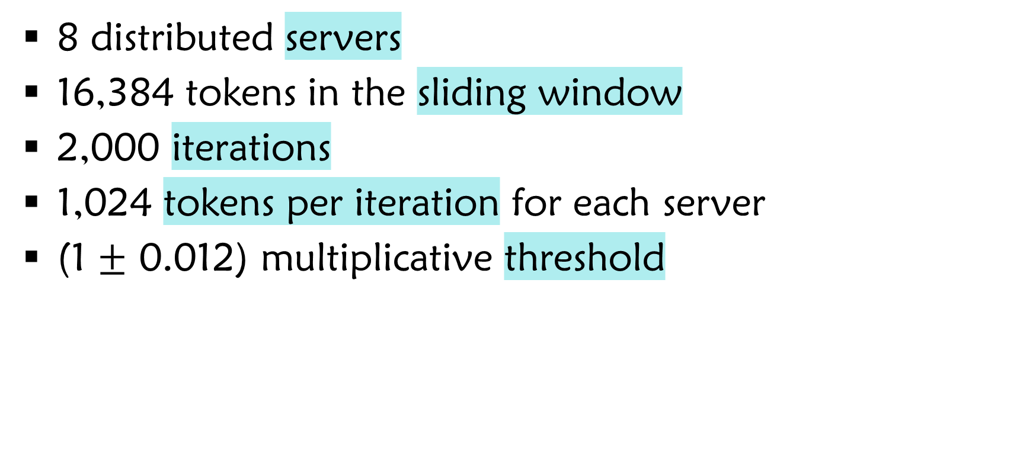
Parameters
8 distributed servers
16,384 tokens in the sliding window
2,000 iterations
1,024 tokens per iteration for each server
(1 $±$ 0.012) multiplicative threshold

Slide 40
Bandwidth / |vector|
Bandwidth
|vector|

Slide 41
Bandwidth / |vector|
Bandwidth
|vector|

Slide 42
Average Amount of Full Syncs Compared to Oracle
Full Syncs
Scheme

Slide 43
Spectral Gap

Slide 44
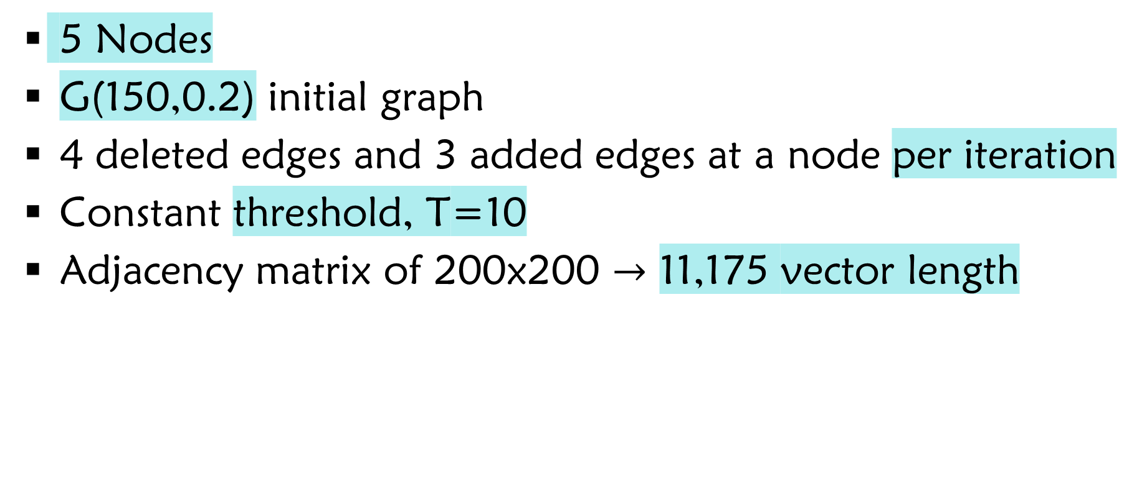
Parameters
5 Nodes
G(150,0.2) initial graph
4 deleted edges and 3 added edges at a node per iteration
Constant threshold, T=10
Adjacency matrix of 200x200 $→$ 11,175 vector length

Slide 45
Spectral Gap Over Time
Spectral Gap’s
Value
Iteration

Slide 46
Bandwidth / Iteration
Bandwidth
Iteration

Slide 47
# Full Syncs / Iteration
# Full Syncs
Iteration

Slide 48
AMS F₂

Slide 49
Parameters
10 distributed servers
Synthetic randomized data
Constant threshold

Slide 50
Bandwidth / iteration 52x47 F₂ Sketch
Bandwidth
Iteration

Slide 51
Bandwidth / |vector|
Bandwidth
|vector|

Slide 52
Bandwidth / |vector|
Bandwidth
|vector|

Slide 53
Average Full Syncs
Bandwidth
Scheme

